Slide 1

PATH TO AI
Technology is the sum of techniques, skills, methods, and processes used in the production of goods or services or in the accomplishment of objectives, such as scientific investigation. Technology can be the knowledge of techniques, processes, and the like, or it can be embedded in machines to allow for operation without detailed knowledge of their workings. Systems applying technology by taking an input, changing it according to the system's use, and then producing an outcome are referred to as technology systems or technological systems.
Notes:
QuickStarter has created an outline to help you get started on your presentation. Some slides include information here in the notes to provide additional topics for you to research.

Slide 2

Difference between AI,ML and DL

Slide 3
What is Machine Learning?

Slide 4
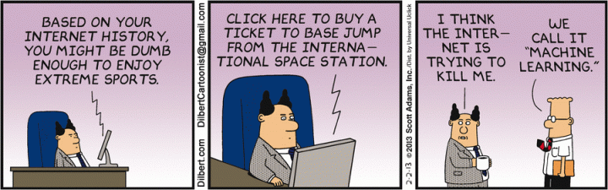
What is Machine Learning?

Slide 5
Machine Learning
Machine learning is a type of artificial intelligence (AI) that
provides computers with the ability to learn without being explicitly programmed.
focuses on the development of computer programs that can change when exposed to new data.

Slide 6
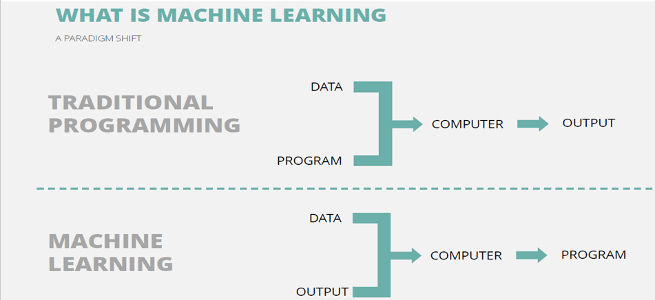
Notes:
Craft an example, differentiate ML from AI

Slide 7
Deep Learning

Slide 8

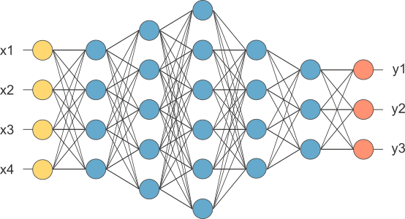
A DEEP Neural Network a.k.a. DEEP LEARNING

Slide 9
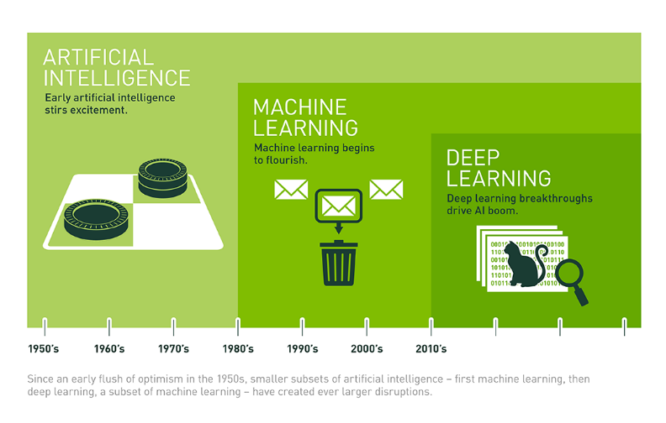

Slide 10
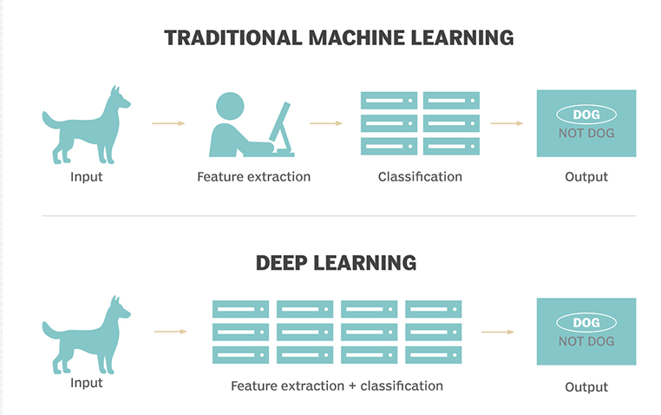

Slide 12
Artificial Intelligence & Data Science
Notes:
But ML is not the only thing connecting AI & DS together.

Slide 13
Artificial Intelligence & Data Science
Artificial
Intelligence
Data Science
Machine
Learning
Machine Learning is the main connection between data science and artificial intelligence since machine learning is the process of learning from data.
Notes:
But ML is not the only thing connecting AI & DS together.
But ML is not the only thing connecting AI & DS together.
Artificial intelligence: a specialism of computer science, focused on giving computers capabilities that imitate aspects of human intelligence. Such areas include pattern recognition, computer vision, and reasoning.
Machine learning: a class of statistical methods of AI, which enables a machine to classify inputs or make predictions about future behavior, based on having been trained with similar previous data. Applications include spam detection, sales forecasting, and product recommendations. Common techniques include linear and logistic regression, decision trees, k-means clustering, naive Bayes, support vector machines.
Deep learning: a specialization of one particular machine learning technique, artificial neural networks, that enables machines to train themselves given sufficiently large amounts of example data. Applications include image and speech recognition, language translation, autonomous vehicles. Deep learning techniques vary, with specializations for particular applications.
Data science: an interdisciplinary field of statistics, ML, computer science and business skills that uses data to understand and affect behavior of people, systems and environments.

Slide 14

Works cited

